Slide 1

CoronaVirus Analysis
Internship Task
Submitted by:
Tayyaba Ejaz

Slide 2
Table of contents
01
02
03
04
What is corona Virus
Dataset Overview
Introduction to corona
What is in the dataset
Dataset Description
Data Exploration
Description of columns
Data Analysis & Exploration

Slide 3

What is Corona Virus
Coronavirus disease (COVID-19) is an infectious disease caused by the virus.

Slide 4
The CORONA VIRUS pandemic had a significant impact on public health and created an urgent need for data-driven insights to understand the spread of the virus
As a Data Analyst , I analyzed the given dataset and drove meaningful solutions and insights

Slide 5
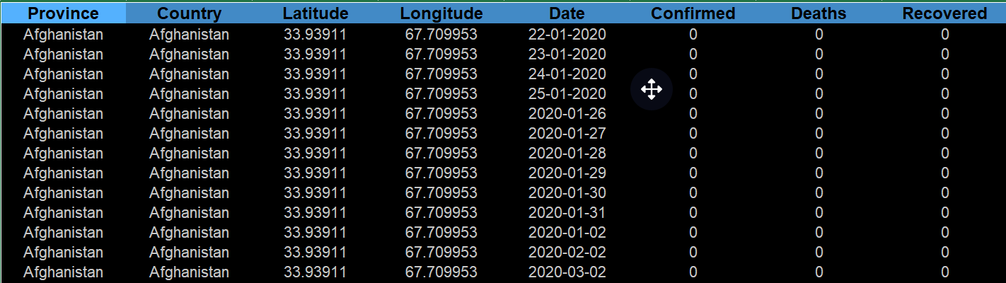
Dataset Overview

Slide 6
Dataset Description
Province: Geographic subdivision within a country/region.
Country/Region: Geographic entity where data is recorded.
Latitude: North-south position on Earth's surface.
Longitude: East-west position on Earth's surface.
Date: Recorded date of CORONA VIRUS data.
Confirmed: Number of diagnosed CORONA VIRUS cases.
Deaths: Number of CORONA VIRUS related deaths.
Recovered: Number of recovered CORONA VIRUS cases.

Slide 7
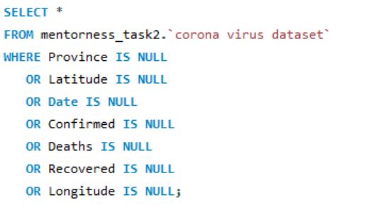
Data Analysis
Checking NULL values

Slide 8
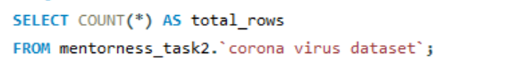
Check Total Number of Rows

Slide 9
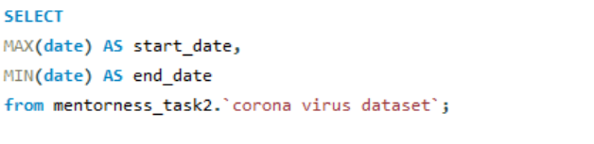
Checking start date and end date

Slide 10
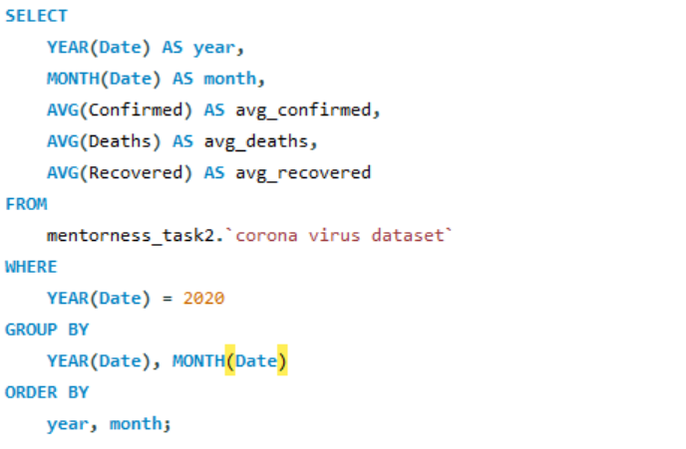
Find monthly average for confirmed, deaths, recovered

Slide 11
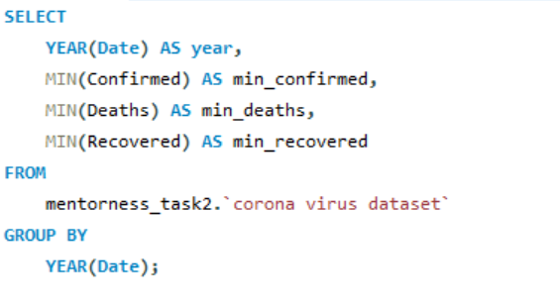
Minimum values for confirmed, deaths, recovered per year

Slide 12
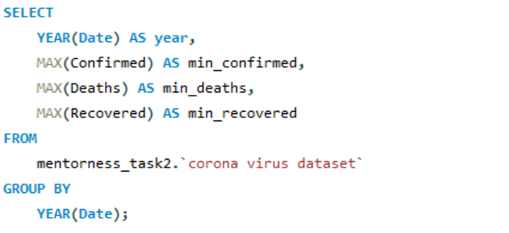
maximum values for confirmed, deaths, recovered per year

Slide 13
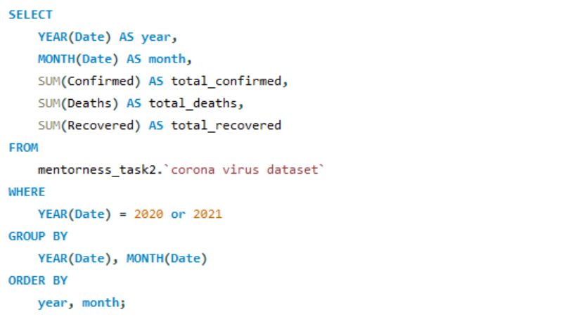
Total number of case of confirmed, deaths, recovered each month

Slide 14
Check how corona virus spread out with respect to confirmed case

Slide 15
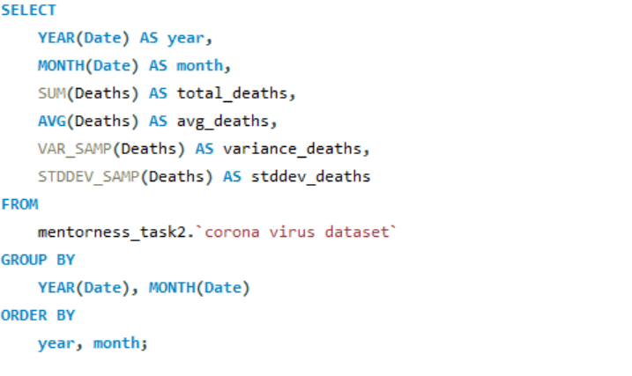
Check how corona virus spread out with respect to death case per month

Slide 16
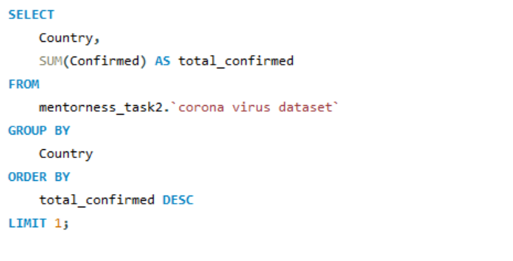
Country having highest number of the Confirmed case

Slide 17
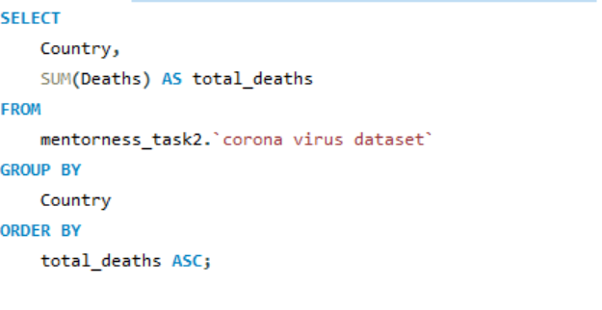
Country having lowest number of the death case

Slide 18
These were exploration done using MySQL

